Slide 1

Home Credit Default Risk
Jun Yin
Springboard Data Science Career Track, Oct 2019
Capstone Project 1: Final Report

Slide 2
Table of Contents
Business Problem/Business Objective
Data Acquisition
Exploratory Data Analysis (EDA)
Distribution of Target Column
Missing Values Treatment
Information Value Analysis
Selected Columns Exploration
Machine Learning Analysis
Data Preparation
Model Evaluation
In-Depth Analysis
Conclusions

Slide 3
Business Problem
Business Issue
Should be the loan approved or not?
How to determine the application?
Business Objective
Build a machine learning model to predict.
Acquire the information from both financial records and others.

Slide 4
Data Acquisition
10 datasets including one main dataset and nine supplementary datasets.
Each row is identified by the feature SK_ID_CURR.
Feature TARGET representing repaid by 0 and not repaid by 1.
Data acquire from https://www.kaggle.com/c/home-credit-default-risk/data

Slide 5
Data Acquisition
The information for all datasets listed below:
application_{train|test}: main table, broken into two files for Train
(with TARGET) and Test (without TARGET).
bureau: previous credits provided by other financial institutions.
bureau_balance: monthly balances of previous credits in Credit Bureau.
POS_CASH_balance: monthly balance snapshots of previous POS (point of sales) and cash loans that the applicant had with Home Credit.
credit_card_balance: monthly balance snapshots of previous credit cards that the applicant has with Home Credit.
previous_application: all previous applications for Home Credit loans of clients who have loans in our sample.
installments_payments: repayment history
HomeCredit_columns_description: descriptions for the columns

Slide 6
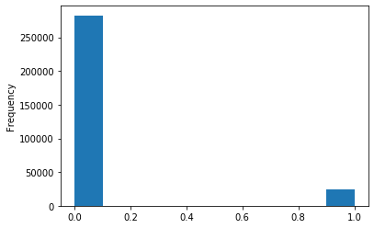
Exploratory Data Analysis (EDA)
EDA finds trends, anomalies, patterns, or relationships within the data.
Examine the Distribution of the Target Column:
Imbalanced class problem
More entries on loan repaid on time
Less entries on loans not repaid

Slide 7
Exploratory Data Analysis (EDA)
Missing Value Treatment
Fill in missing values with various strategies
Filling in with mean;
Filling in with most frequent value/item;
Filling in with 0;
Information Value Analysis
Determine columns have predict power or influence
Select IV scores between 0.01 and 0.8

Slide 8
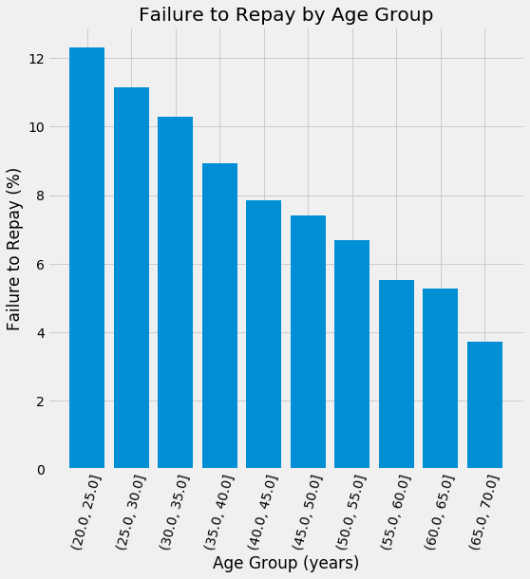
Exploratory Data Analysis (EDA)
Observe from “Failure to Repay by Age Group”
The senior customers are more likely to repay the loan.

Slide 9
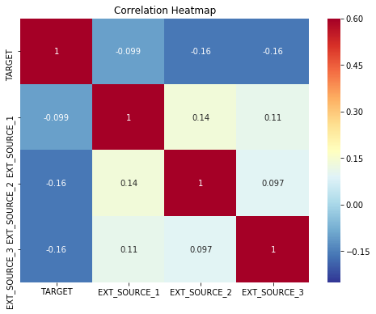
Exploratory Data Analysis (EDA)
High IV scores:
EXT_SOURCE_1, EXT_SOURCE_2, DAYS_BIRTH and EXT_SOURCE_3 have the highest IV scores;
Explore EXT_SOURCE_1, EXT_SOURCE_2 and EXT_SOURCE_3 first, check DAYS_BIRTH later.
EXT_SOURCEs have the most negative correlations with the TARGET variable. When EXT_SOURCE increases, it is more likely to repay the loan.

Slide 10
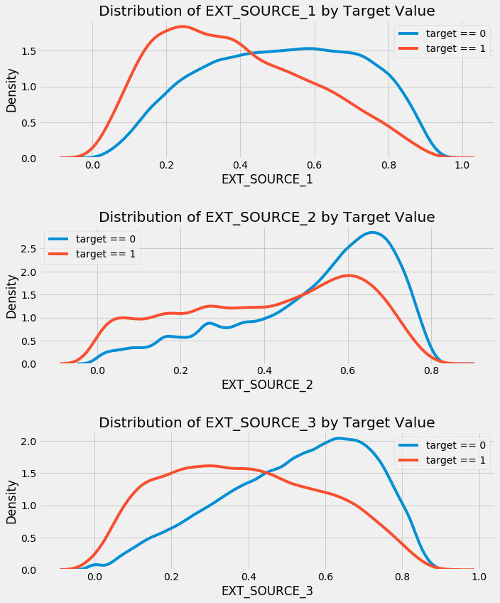
Exploratory Data Analysis (EDA)
Observe from pair plots:
EXT_SOURCE_3 shows the greatest
difference with TARGET feature that
applicants tend to repay the loan if
EXT_SOURCE_3 is higher.

Slide 11
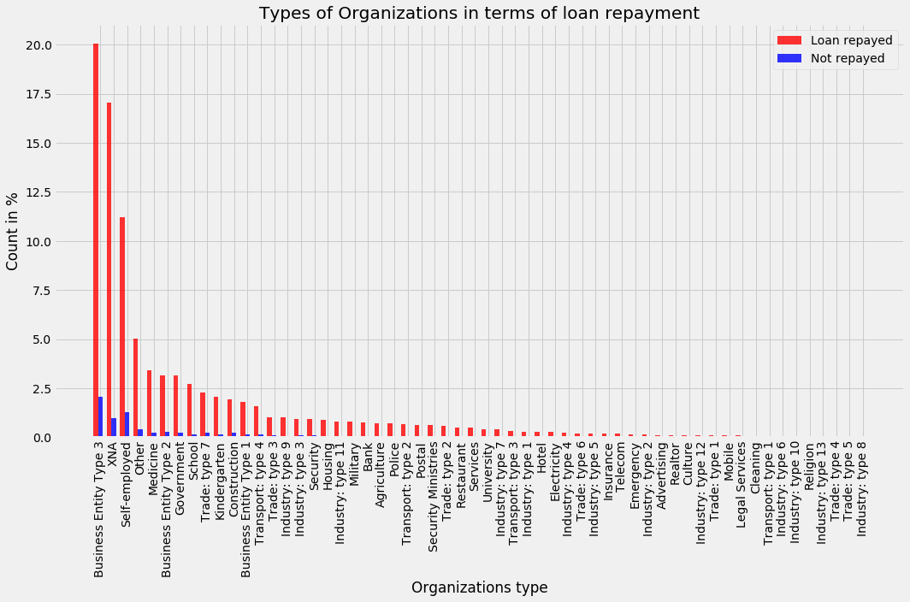
Exploratory Data Analysis (EDA)
Observe from “Types of Organizations in Terms of Loan Repayment”
"Business Entity Type 3" tends to repay the loan comparing to other organizations.

Slide 12
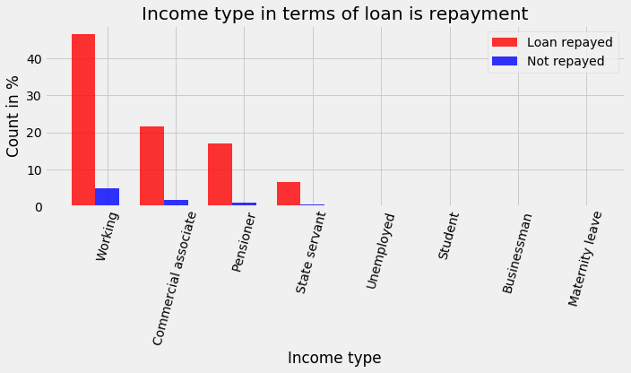
Exploratory Data Analysis (EDA)
Observe from “Income Type in Term of Loan Repayment”
Working group tend to repay the loan comparing to other groups.

Slide 13
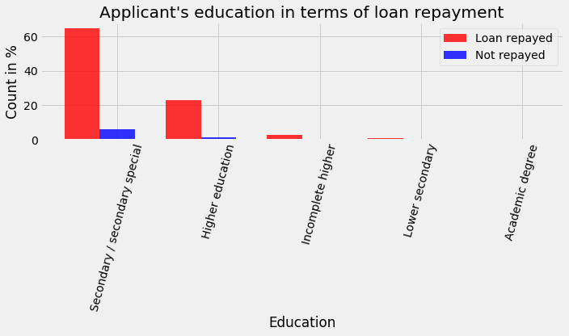
Exploratory Data Analysis (EDA)
Observe from “Applicant’s Education in Terms of Loan Repayment”
Secondary/secondary special tend to repay loan comparing to other groups.

Slide 14
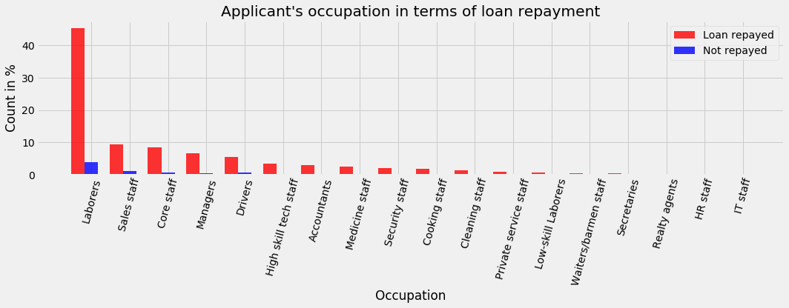
Exploratory Data Analysis (EDA)
Observe from “Applicant’s Occupation in Terms of Loan Repayment”
"laborers", "Sales staff", "Core staff", "Managers", "Drivers", however, the trend is not that obvious comparing to other occupations.

Slide 15
Machine Learning
Data Preparation:
More than 50% missing values, but less than 80%, decide to keep.
Apply one-hot encoding to deal with categorical variables.
To find out the best machine learning model for this project, three different data preparation approaches were applied:
Approach 1: Model evaluations are run right after missing value filling and categorical variables encoding. The result is the baseline for model evaluation.
Approach 2: In order to generate more features, supplementary datasets are merged into the main dataset.
Approach 3: The in-depth analysis, including information value analysis and multicollinearity are applied in this approach to avoid over-fitting.
Split data into two parts: 70% for training and 30% for testing.

Slide 16
Machine Learning
Model Evaluation by Approach 1:
Confusion_matrix:
[[83788 1053]
[ 6685 728]]
Classification report:
precision recall f1-score support
0 0.93 0.99 0.96 84841
1 0.41 0.10 0.16 7413
ROC-AUC score of the model: 0.7522257459682484

Slide 17
Machine Learning
Model Evaluation by Approach 2:
Confusion_matrix:
[[83708 1035]
[ 6680 831]]
Classification report:
precision recall f1-score support
0 0.93 0.99 0.96 84743
1 0.45 0.11 0.18 7511
ROC-AUC score of the model: 0.769796007452093

Slide 18
Machine Learning
Model Evaluation by Approach 3:
Confusion_matrix:
[[84404 339]
[ 7287 224]]
Classification report:
precision recall f1-score support
0 0.92 1.00 0.96 84743
1 0.40 0.03 0.06 7511
ROC-AUC score of the model: 0.7146383322781984

Slide 19
Machine Learning
Approach | Model | ROC-AUC
1 | Lightgbm | 0.7522257459682484
 | Random Forest | 0.5001905604737972
 | XGBoost | 0.5083663311963755
 | CatBoost | 0.5127446516061206
2 | Lightgbm | 0.7697960074520930
 | Random Forest | 0.5004482826475651
 | XGBoost | 0.5130236655780216
 | CatBoost | 0.5217810129101755
3 | Lightgbm | 0.7146383322781984
 | Random Forest | 0.5008240960706977
 | XGBoost | 0.5020686407435064
 | CatBoost | 0.5055747336202197
Summary of different models under various approaches

Slide 20
Conclusions
Light Gradient Boosting Machine Learning model shows the best scores from 71.46% to 76.98%.
The goal of model accuracy or model robustness decides which approach will be applied.
The model is evaluated by confusion matrix and the ROC-AUC score
Feature engineering, information value analysis and multicollinearity was employed to increase the model robustness.
The machine learning models can be used for banks to determine the likelihood that applicants are capable to repay loans.

Slide 21
Thank you

